Slide 1
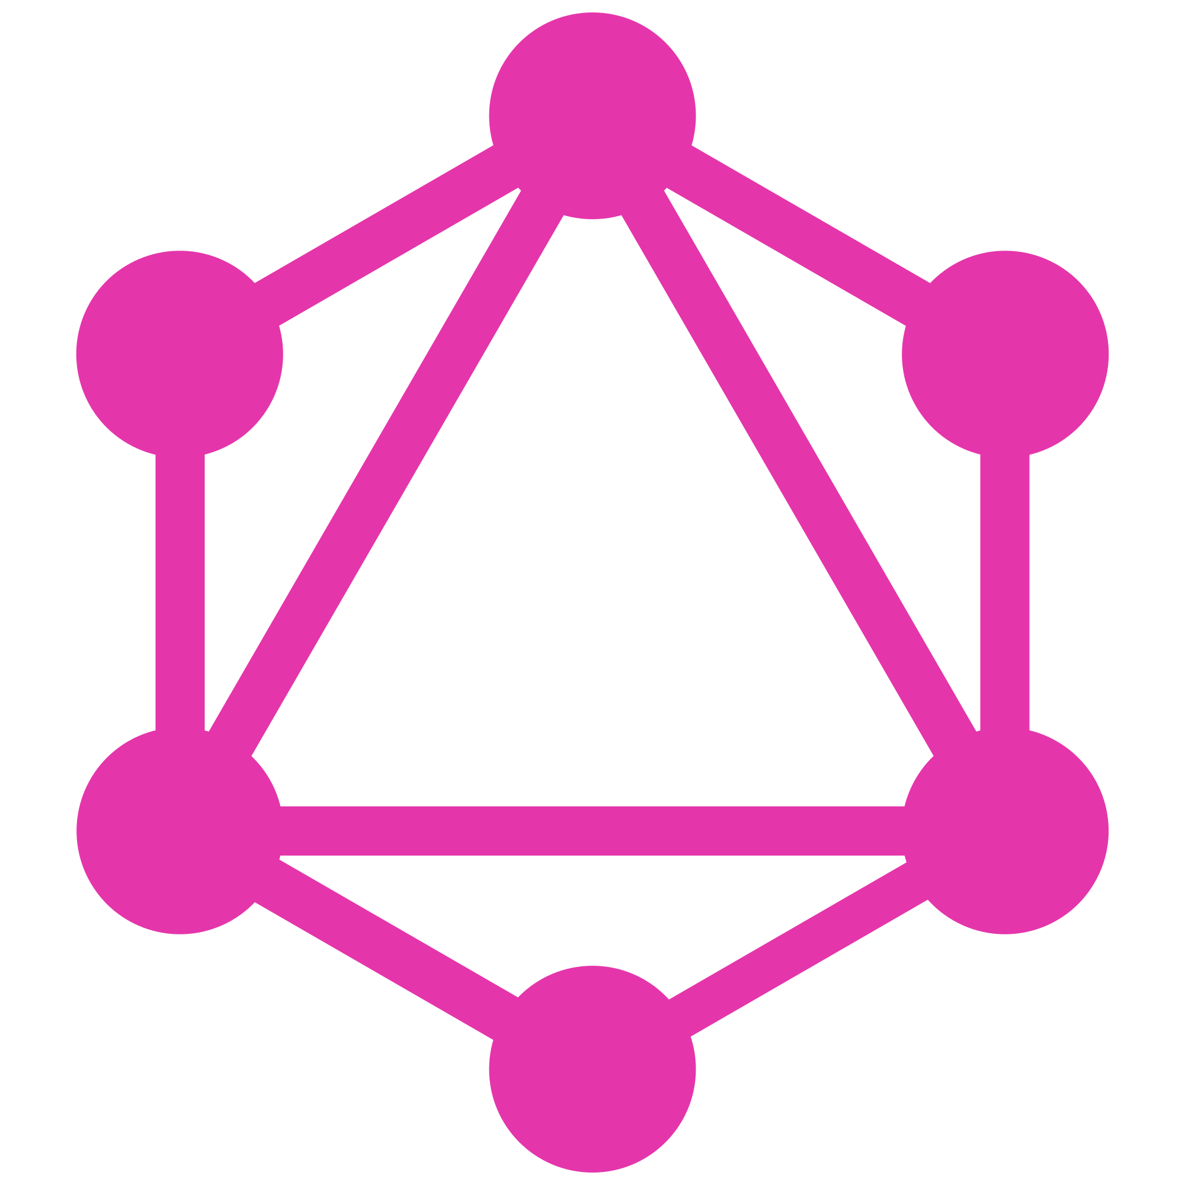
Introduction to GraphQL
a long-short story about graphql

Slide 2
Story behind creation of GraphQL,
and the story begin at 2012

Slide 3
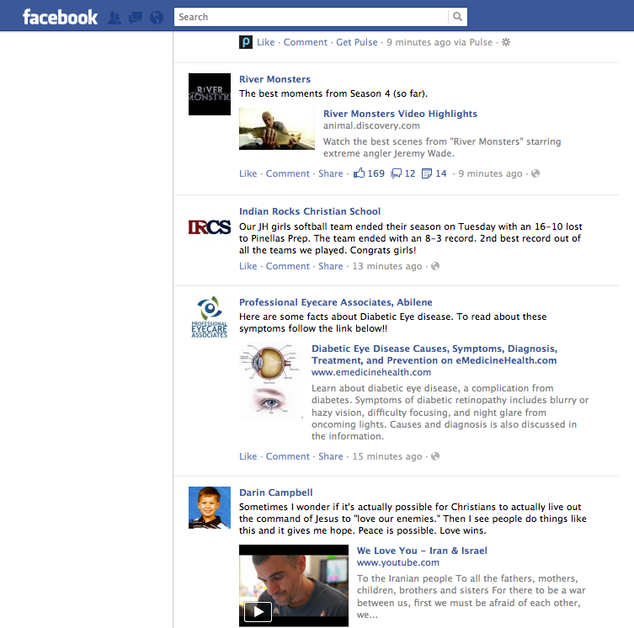
Challenge
Challenge
Facebook needs to build a new generation of their iOS app using native technology from scratch.
All logic happened in the app and it treated server like just an API to load data from.
Newsfeed wasn't just list of stories or each story had list of comments.
Industries have shifted to mobile interaction.
Industries have shifted to mobile interaction.
This is like interconnected and nested and recursive. This is complicated things.
Notes:
Previously facebook use HTML5 for iOS app

Slide 4
Problems
APIs not really designed to allow to expose a full rich newsfeed like experience.
APIs didn't have sort of the hierarchical nature.
APIs didn't have easy ability to select what you needed.
APIs didn't have ability to display a list of heterogeneous feed stories.
Network issues
What facebook doesn’t have at that time.
Notes:
Hierarchical nature like nested data

Slide 5

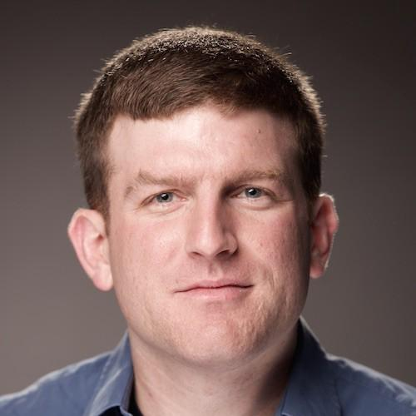

Meet this guys, Creator of GraphQL
Lee Bryon
Dan Schafer
Nick Schrock

Slide 6
A Vending Machine Stories

Slide 7


Slide 8
Recap

Slide 9
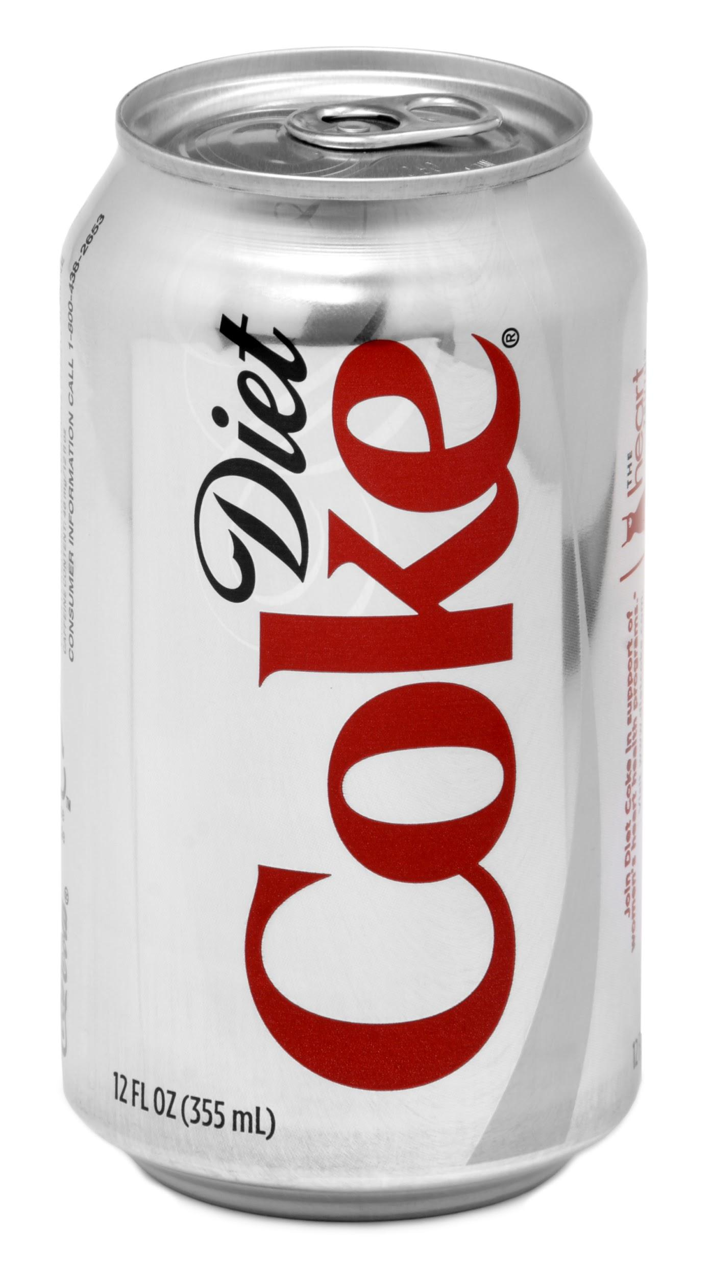
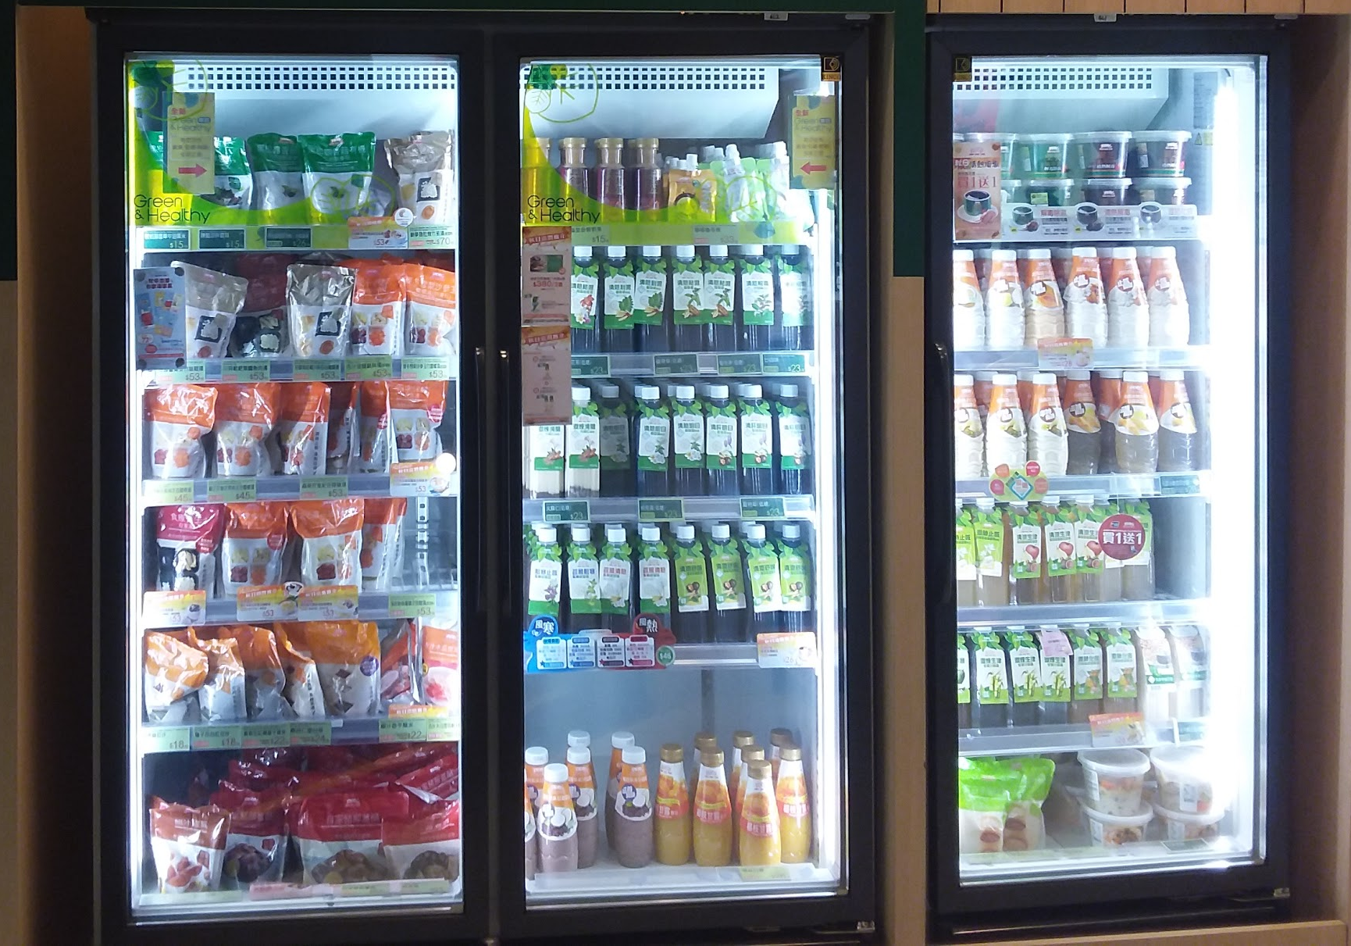

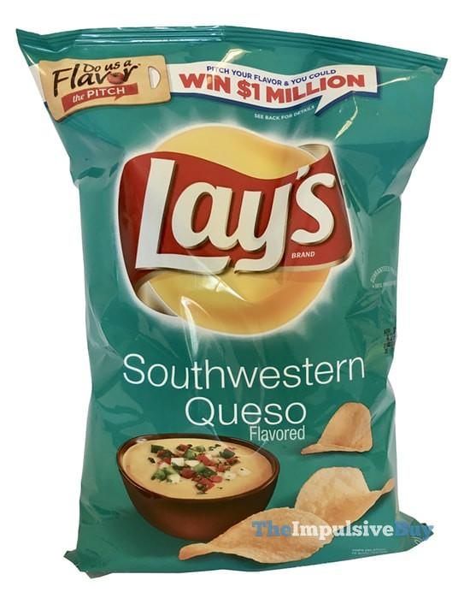
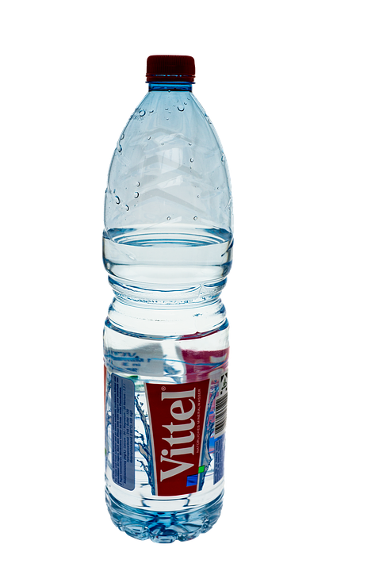
Before GraphQL
get a diet coke
press a button
press a button
get a bag of lays
press a button
get a mineral water

Slide 10
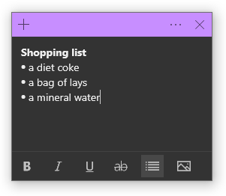

With GraphQL
vending machine give you all items in one bag
vending machine getting all items in the shopping list
create a shopping list

Slide 11
So, What is actually GraphQL?

Slide 12
Definition of GraphQL
“GraphQL is a query language for your API that shifts the contract between clients and servers that allows the server to say ‘these are the capabilities that I exposed’ and allows the clients to describe their requirements in a way that ultimately empowers product developers to build the products they want to create.”
— Dan Schafer, GraphQL Co-Creator
from Co-Creator

Slide 13
Definition of GraphQL
GraphQL is a query language for querying data from various source of data from client-side applications
in its simplest form

Slide 14
GraphQL Component
Schema
Query
Resolver
3 key components

Slide 15
GraphQL Schema
type User {
id: ID!
name: String!
age: Int!
hobbies: [Hobby] } type Hobby {
id: ID!
activity: String!
users: [User] }
...
type Query {
users: [User]
user(name: String!): User
hobbies: [Hobby]!
hobby(activity: String!): Hobby
... }
type Mutation {
addUser(name: String!, age: Int!): [User]
addHobby(activity: String!): [Hobby]!
... }
schema {
query: Query
mutation: Mutation }
example schema.graphql

Slide 16
GraphQL Resolver
Query: {
user(obj, args, context, info) {
return context.db.getUserByName(args.name).then(
userData => new User(userData)
)
}
... },
Mutation: {
AddUser(obj, args, context, info) {
return context.db.addUser(args).then(
userData => new User(userData)
)
}
... },
User: {
hobbies(obj, args, context, info) {
return obj.hobbyIDs.map(
id => context.db.getHobbyByID(id).then(
hobbyData => new Hobby(hobbyData)
)
)
}
},
...
A resolver function receives four arguments :
obj The previous object, which for a field on the root Query type is often not used.
args The arguments provided to the field in the GraphQL query.
context A value which is provided to every resolver and holds important contextual information like the currently logged in user, or access to a database.
info A value which holds field-specific information relevant to the current query as well as the schema details.
example in JS

Slide 17
GraphQL Query
Request
Response
query { user(name: “John”){
name
age
hobbies { activity } } }
{ “user”: {
“name”: “John”
“age”: 32
“hobbies“:{ “activity”: “Coding” } } }
example

Slide 18
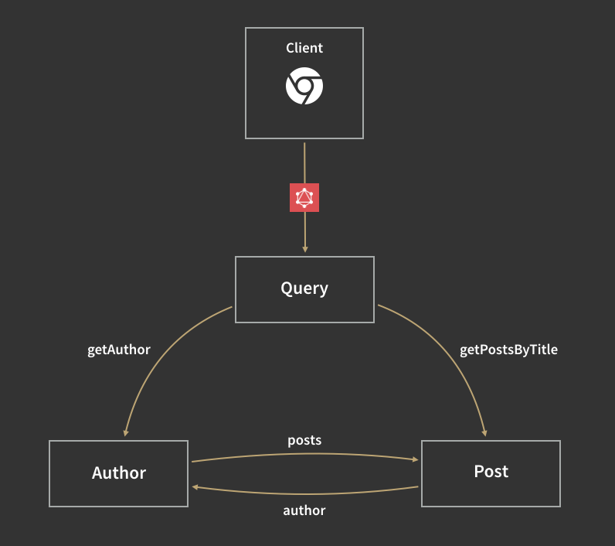
getUser
getHobby
hobbies
User
Hobby
users

Slide 19
How the GraphQL solved the problems

Slide 20
(Re-)defined REST Problem
A lot of endpoints
Over-fetching or under-fetching of data
Difficulty understanding APIs
Difficulty API versioning
Difficulty handling network/graph data

Slide 21
Problem | A lot of endpoints
GraphQL endpoint
REST API endpoints
http://example.com/graphql
http://example.com/v1/user/:id
http://example.com/v1/post/:id
http://example.com/v1/comment/:id
`query { users{ posts{ comments } } }`

Slide 22
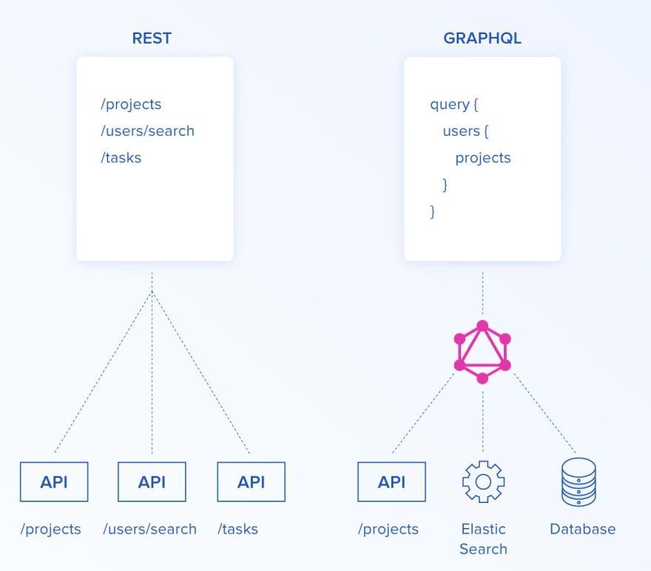

Slide 23
Problem | Over-fetching or under-fetching of data
 | GraphQL | REST API
Request | query { users { name } } | GET /users
Response JSON | { “users”: [ { “name”: “John” }, { “name”: “Doe” }, ] } | { “users”: [ { “name”: “John”, “age”: 32, “sex”: “Male” }, { “name”: “Doe”, “age”: 36, “sex”: “Male” }, ] }

Slide 24
Problem | Over-fetching or under-fetching of data
 | GraphQL | REST API
Request | query { users { name salary } } | GET /users GET /salary
Response JSON | { “users”: [ { “name”: “John”, “salary”: “$750” }, { “name”: “Doe” , “salary”: “$900” }, ] } | { “users”: [ { “id”: 1, “name”: “John”, “age”: 32, “sex”: “Male” }, { “id”: 2, “name”: “Doe”, “age”: 36, “sex”: “Male” }, ] } { “salary”: [ { “id”: 1, “salary”: “$750” }, { “id”: 2, “salary”: “$750” }, ] }

Slide 25
Problem | Difficulty API versioning
GraphQL
REST API
doesn’t need versioning
http://example.com/v1/users
http://example.com/v2/users
….
http://example.com/vN/users
Notes:
When data structure is evolve

Slide 26
Problem | Difficulty handling network/graph data
GraphQL
REST API
query{ users{ name friends{ name friends{ name } } } }
GET /users
GET /friends
GET /users
GET /friends
GET /users

Slide 27
Problem | Difficulty understanding APIs
GraphQL
REST API
Query
Mutation
Subscription
GET
POST
DELETE
PUT
...
Notes:
Just one of the sample

Slide 28
Benefits of using GraphQL

Slide 29
Benefits
Easy to start with
Enables rapid product development
No wasted bits over the wire
Easy to keep consistent and to govern
Self documenting API
and more ...

Slide 30
GraphQL Ecosystem

Slide 31



The Ecosystem | Servers
NodeJS | Ruby on rails | Python | more ...
 |  |  | https://graphql.org/code/

Slide 32







The Ecosystem | Databases
SQL | NoSQL

Slide 33



The Ecosystem | Client / Frontend

Slide 34


The Ecosystem | Tools / Services

Slide 35
What can we do more with GraphQL?

Slide 36
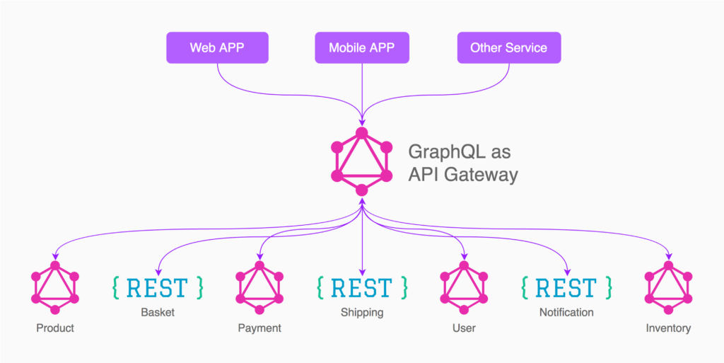
GraphQL as API Gateway
Thanks to “Schema Stitching” idea

Slide 37
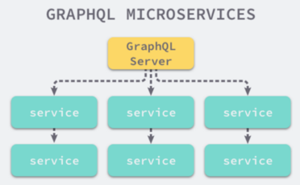
GraphQL as a Glue for microservices
read more at https://medium.com/@mena.meseha/practice-of-graphql-in-microservice-architecture-e8f2d698f93b

Slide 38
Try it now,
https://github.com/ilmimris/devday/2/graphql

Slide 39
Bonus

Slide 40
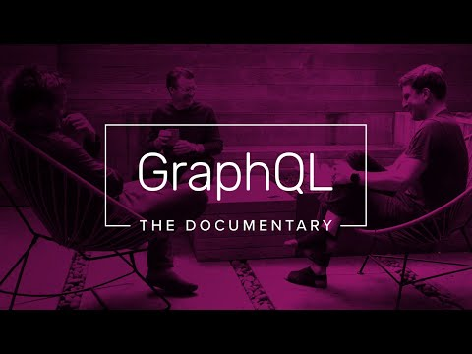
Bonus | GraphQL : The Documentary

Slide 41
See you next time.

